Slide 1
A Book Management Program
December, 2022
Open-source Development Project
18th

Slide 2

All about Library Management
Reasons for choosing the topic
Design
Implementation
Execution Information
Future Work Developer Introduction

Slide 3

Why book management?
It was one of the systems that can be easily accessed in everyday life. In the case of one-person individual bookstores, there are still places where book stocks are written by hand.

Slide 4


Framework used in this project
Book management desktop application
Swing
JDBC
MySQL
GUI Implementation, Provides a sophisticated interface for your projects
Actively utilize and use JAVA learned in lectures
Provides various APIs, Free and reliable open source

Slide 5

Our main feature is
a simple UI and active use of JAVA learned during lectures for more convenient use by users.

Slide 6
Login
Book Management
User
Library Management
Manager
Rental and Return

Slide 7



User-Admin Page
General Membership
Admim
Sign Up
Login
Check registered members
Forced withdrawal possible
Book Management
Username Password name, gender
date of birth, phone number
Personal information can be changed
You can see a list of currently registered members
The right to add, return and borrow books
Members can be forcibly withdrawn with admin

Slide 8

Library Management Main Page
Add Book
List Lookup
Book Rearch
Rental/Return
Rental status
Enter book information
Full List
Search by book name
Current Stock
User rental and return
Name, author, publisher and publication date, and remaining stock
If you enter the book number and book name along with your user ID, you can borrow/return the book
Print borrowed and returned dates
Book number, name, author, publisher, date of publication required
Search among current stock

Slide 9

Shall we look at the program source code?
If you look at the source codes that implement each function, you can see how the screen is configured.
I'll show you while running it.
How was each part implemented?

Slide 10
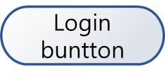
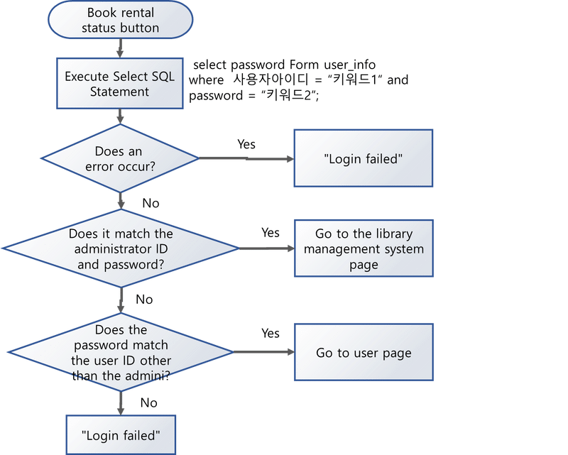
Login Design Flow chart
both users and admins
Distinguishes who logs in and brings up another page

Slide 11
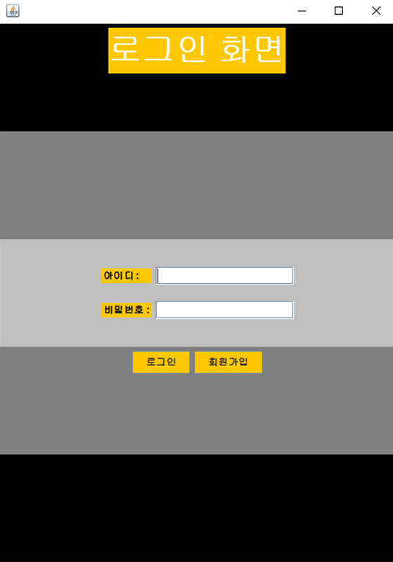
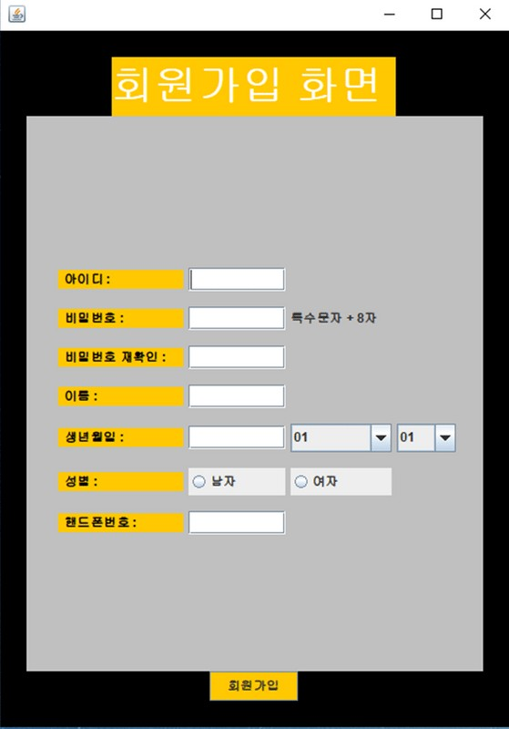

Slide 12
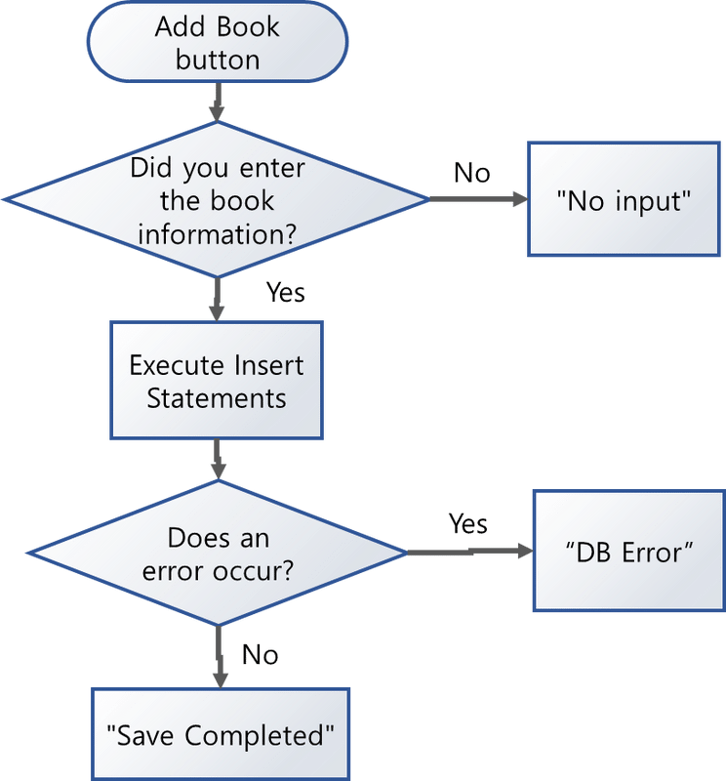
Book Addition Flow chart
Add new books to your inventory
Enter book number, book name, author, publisher, publication date

Slide 13
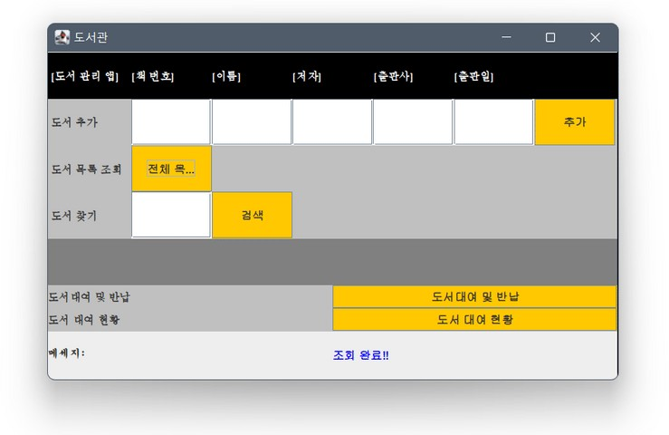


Slide 14
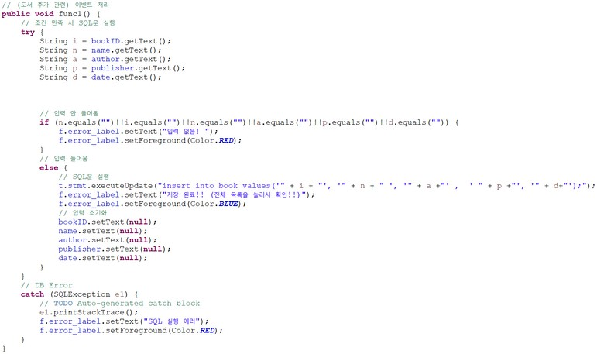

Slide 15
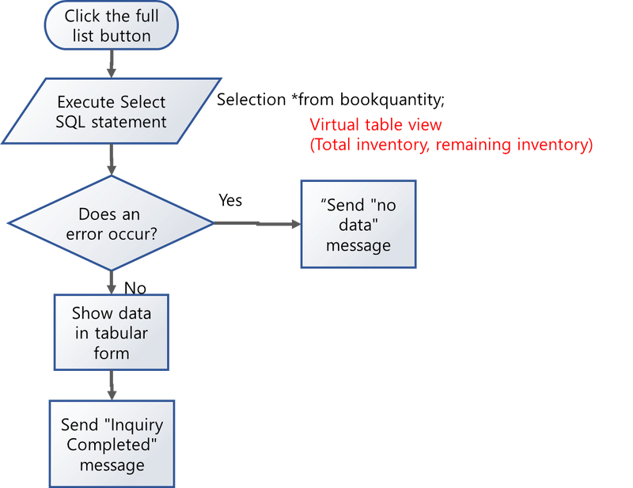
Full List Query Flow chart
All currently registered books
To view information and remaining stock after rental

Slide 16
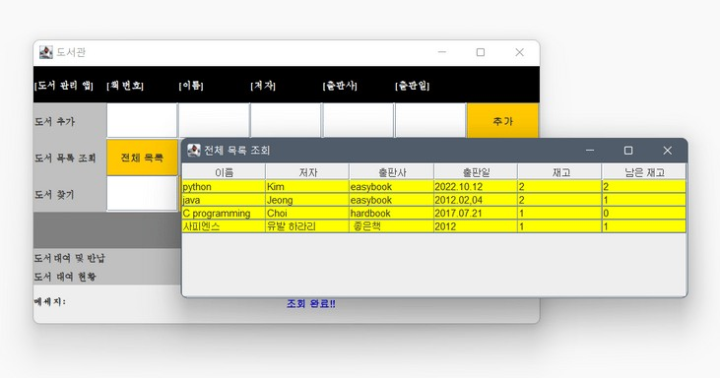


Slide 17
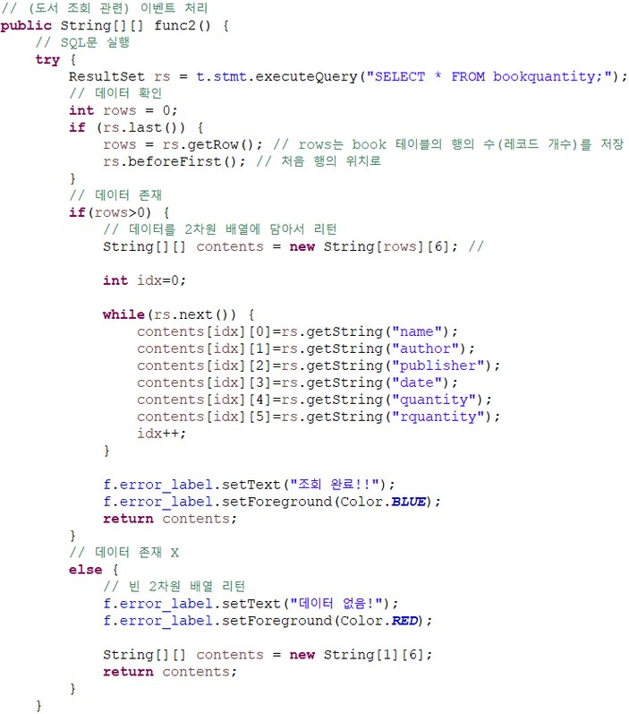

Slide 18
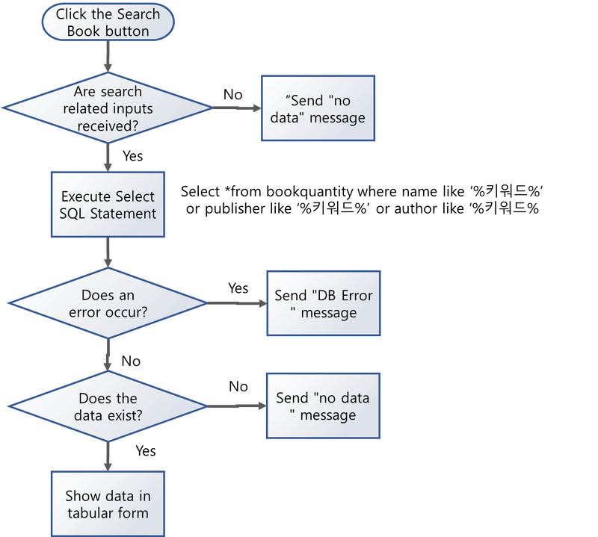
Book Search Flow Chart
Enter the information of the book you are looking for
To view information and remaining stock after rental

Slide 20
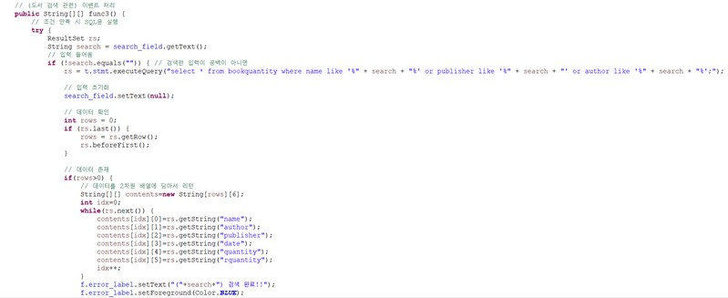

Slide 21
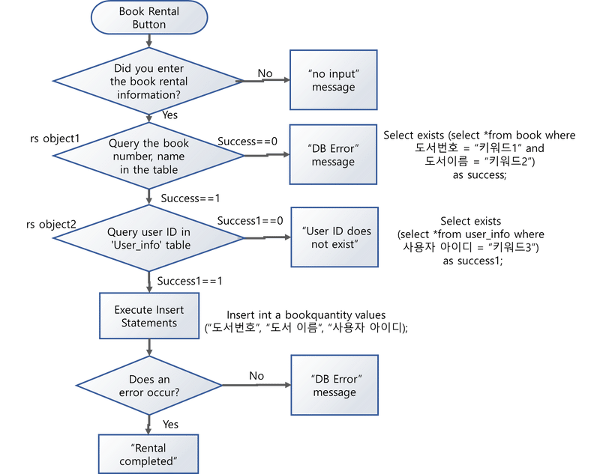
Book
Rental/Return Flow chart
To allow users to freely return and borrow books
Enter book information, book name, and user ID

Slide 22
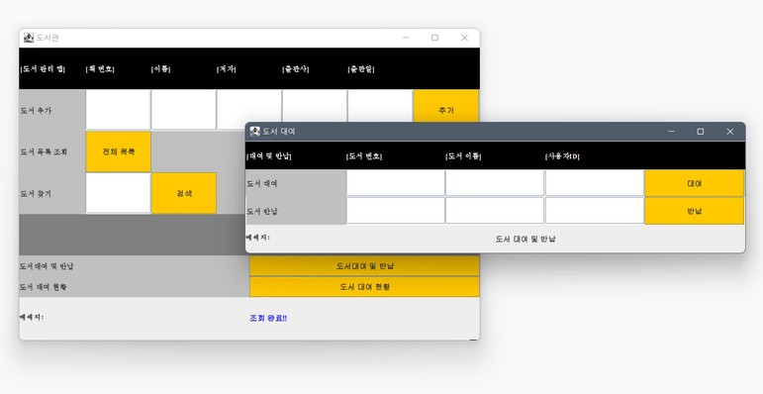

Slide 23
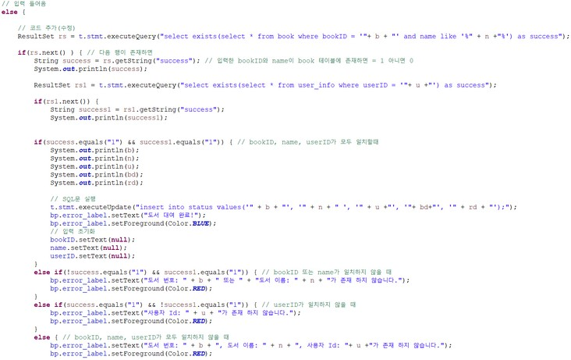

Slide 24
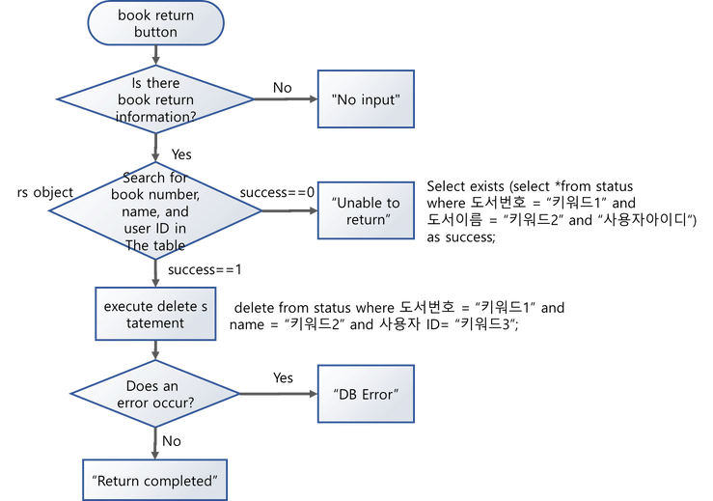
Book
Rental/Return Flow chart
To allow users to freely return and borrow books
Enter book information, book name, and user ID

Slide 25
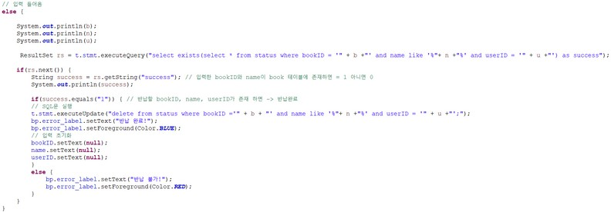

Slide 26
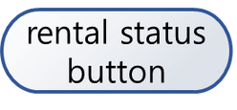
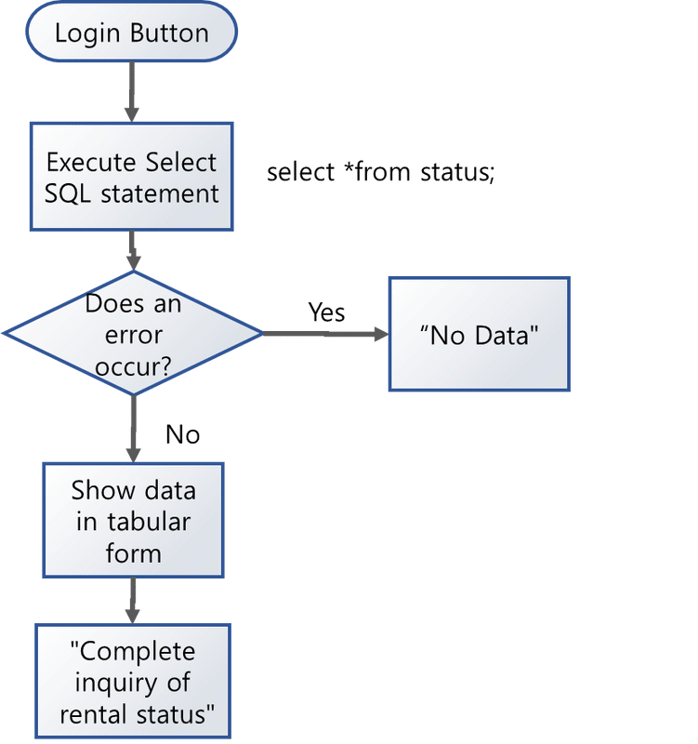
Rental Status Flow chart
Show rental and return dates
Shows which user borrowed which book and when

Slide 27
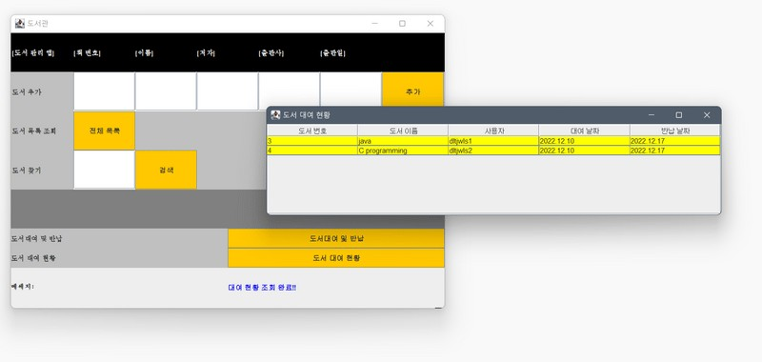

Slide 28
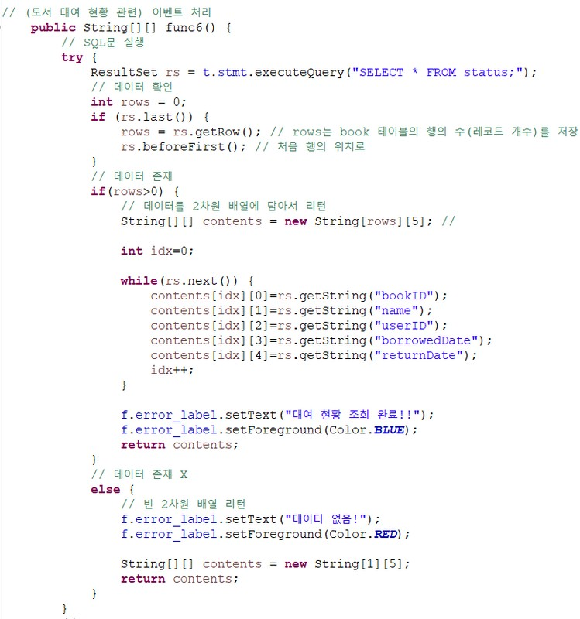

Slide 29




Run The Program

Slide 30

"If you can code, you can create something in a sitting position, and no one will be able to stop you."
MARK ZUCKERBERG

Slide 31
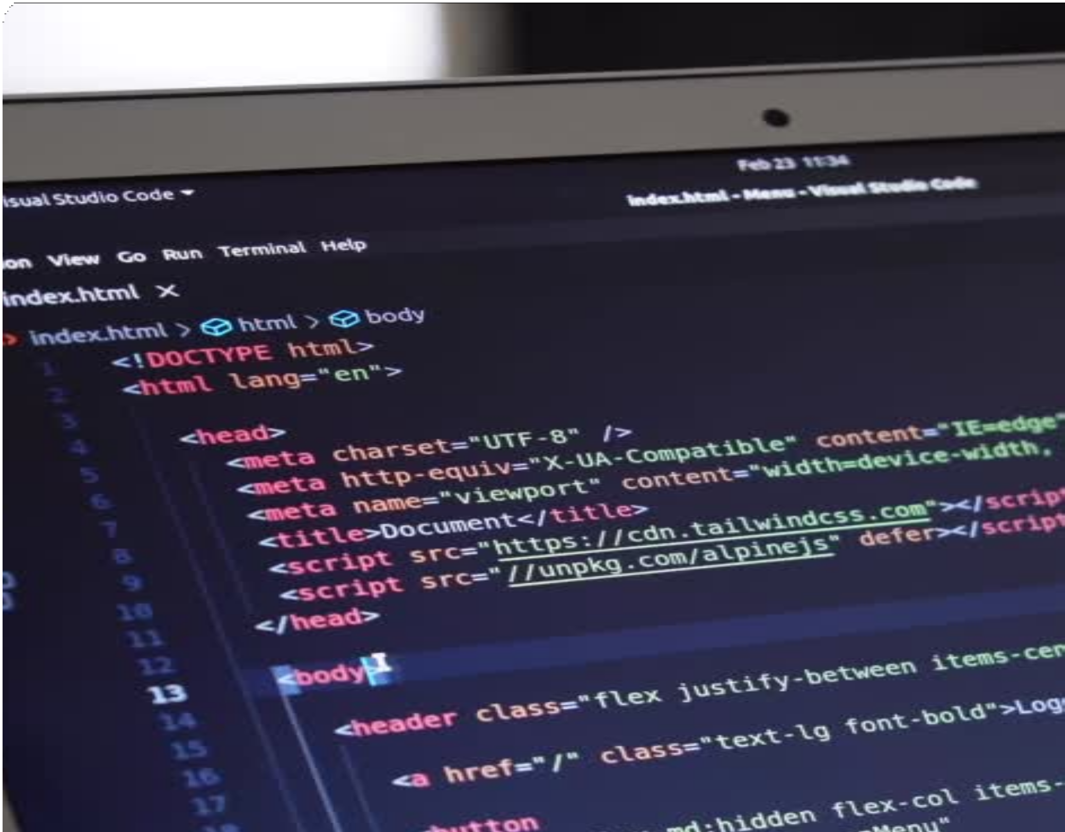
What we want to do; our future work
There are more functions to be added
Backward function
List of recommended books Show Simple Book Cover
Return and rent books with QR code

Slide 32

Do you have any questions?
Just ask us! I hope you had a good time.

Slide 33





PEOPLE WHO MADE THE PROJECT
DH JOE
Department of Software
TH SEO
Department of Software
SJ LEE
Department of Software
Back development and database implementation
Implement UI and other features
Implementation other features and announcement

